Slide 1



to
2024

Slide 2


Live Your Dream
Summer Earn and Learn 2024

Slide 3








"Proper preparation prevents
poor performance."
James Baker
Former Secretary of State

Slide 4

Agenda
Navigating Your First Few Days
Employer Expectations
Be a STAR Employee
Decision-Making & Problem Solving
Career Path
Timesheet Requirements & Payroll processes

Slide 5




Icebreaker
Split into groups of 5
Pick a team leader
15 minutes

Slide 6



Workbook
When you see this icon, grab your workbook.

Slide 7

Workplace
Basics
Navigating Your First Few Days

Slide 8

What's its function?
The function of a clock is to tell us the time, which would be its mission.
Within an organization, each employee has a specific role and function.
Each employee has their own unique talents, abilities, and perception.

Slide 9





First Day
Page 1
Who do you report to?
What number do you call in case of an emergency?
Where do you go?
What time do you need to be there?
How will you get there?
What do you need to bring?
What do you need to wear?

Slide 10

Identification
Driver's License or State ID
Social Security Card
Your Bank Account Information
Bank Name, address, phone number, account #, routing #
Notepad and Pen
‘Schedule A’ Letter
Documentation that indicates your disability
What to Bring

Slide 11


Dress for Success
Most companies require their employees to follow a certain dress code.
In some work environments, you might be required to wear a uniform.
Ask your employer what their dress code is so you can follow it.
Avoid wearing dirty clothing and avoid wearing clothing with holes.
Focus on performance.

Slide 12


Professional
Conduct
First impressions are important.
Your attitude to what you wear will show how serious you are.
When a company hires you, you
become a representation of them.

Slide 13



What to Wear
Regardless of your work environment, remember these basic tips:
Make sure you shower and your hair is clean and neatly styled, avoid bright unnatural colors.
Keep your outfit simple and make sure it is clean without wrinkles or holes
Wear simple jewelry/accessories and avoid wearing too much make-up and cologne.
Wear appropriate shoes such as closed-toed heels, flats, or short boots.

Slide 14



What Not to Wear
Headphones
Faded, frayed, or holey clothes
Ripped jeans
Sandals/flip flops
Pajamas, house shoes
Shorts
Cologne
Revealing or tight clothing
Unprofessional accessories
Poorly fitting clothes or shoes
Stained or wrinkled clothing

Slide 15





Transportation
Prepare by planning for your trip based on your method of transportation and how long it will take to get to your job on time.

Slide 16


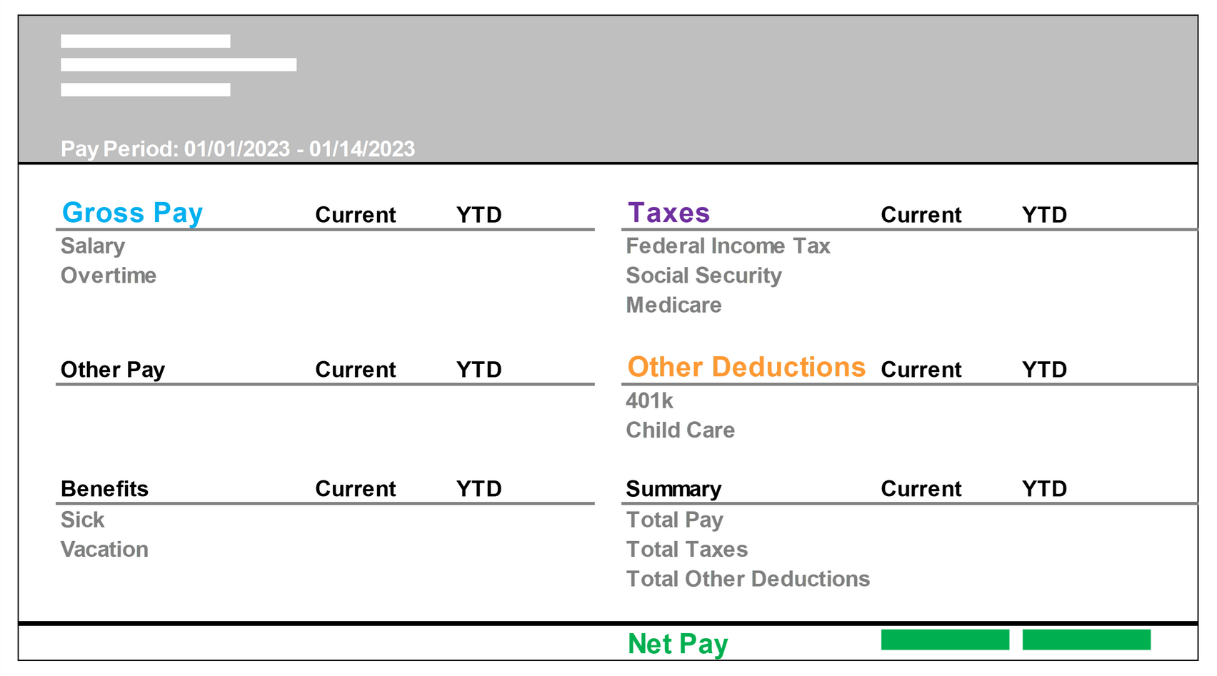




Paycheck Basics:
Reading Your Pay Stub
Gross Pay
Taxes
Other Deductions
Net Pay
1
1
2
2
3
3
4
4
Report any mistakes to your employer immediately.

Slide 17

Timekeeping
Page 7
It's your responsibility to track the hours you work to make sure that your paycheck is correct.
Report any errors as soon as you see them to have them corrected.
Who would you report any errors to?

Slide 18

Attendance
Page 7
How do you call in sick?
What time do you need to be there?
What time does your shift end?

Slide 19

Cell Phones
Unless otherwise approved with your employer, please do not use your cell phone while clocked in during your shift.
Most companies have an emergency line for you to provide to family members to be used ONLY in the case of an emergency.

Slide 20

How Big is the Problem?
55% of distractions in the workplace are caused by cellphones
75% of employers say that 2+ hours are lost every day due to distractions
28% increase in mistakes after an employee gets a phone call

Slide 21






Navigating
Your First Few Days

Slide 22


Reasonable Accommodations
According to the American with Disabilities Act (ADA)
Larger computer monitor
A written list of instructions
Granting more time to accomplish tasks
Anything that will help you to perform your job duties
To receive a workplace accommodation, you must put in a request.

Slide 23





Self-Advocacy
Page 9
Understand your needs.
Know what kind of support you need.
Communicate these needs to others.

Slide 24

Harassment
Is the unwelcome and sometimes unlawful conduct that demeans, insults, and offends.
Federal law prohibits harassment of individuals based on protected characteristics.
If you are being harassed, tell your supervisor, and follow your employer's anti-harassment policy.

Slide 25

Employer Expectations

Slide 26





Job Descriptions
Page 11
The company is giving you a look into what they will expect from you by listing the job duties, requirements, and details that will help you to succeed in your job.
Job Duties
Requirements
Other Details

Slide 27
Employer Expectations
Come to work prepared, on time, clean, and wearing clean clothing.
Come to work each scheduled shift and stay until your shift is over.
Do your assigned tasks and duties as instructed.
Follow all company rules.
Don't steal from the company and coworkers.
Be respectful and keep your workplace clean.
Don't bring weapons to work or come to work under the influence of drugs and/or alcohol.
Do not be on your cell phone while clocked in.

Slide 28

Professional Conduct
How you present yourself
The way you carry yourself
The way you dress
Your attitude
By doing the right thing even when no one is watching, whether on or off the clock

Slide 29

Be a STAR Employee

Slide 30

Employers Most Wanted
Communication & Teamwork
Reliability
Customer Service & A Positive Attitude
Creativity
Adaptability
Critical Thinking & Problem Solving
Organization & Planning
Initiative & Work Ethic
Time-Management
Leadership
Learning
Technology
Conflict Resolution

Slide 31



Soft Skills
These are the skills we use when we handle ourselves and how we interact with others.
If you invest time and effort into developing and practicing them, it will pay off in your upcoming job and will prepare you for a positive future.

Slide 32

"Your smile is your logo, your personality is your business card, how you leave others feeling after having an experience with you becomes your trademark."
Jay Danzie
Author

Slide 33

Page 13
Answer the following:
What soft skills am I great at?
What soft skills do I need to work on?
How do I treat others?
How do I communicate with others?
What would others say about how I treat them?

Slide 34
"The greatest problem in communication is the illusion that it has been accomplished".
George Bernard Shaw
Dramatist & Literary Critic

Slide 35
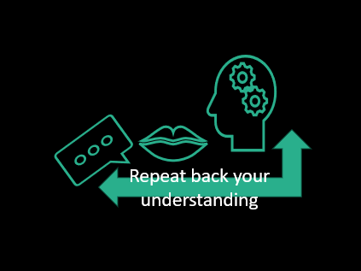

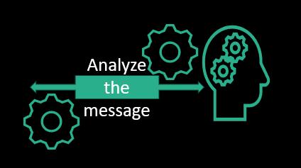

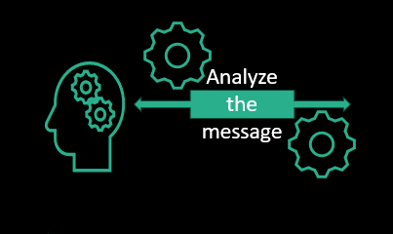
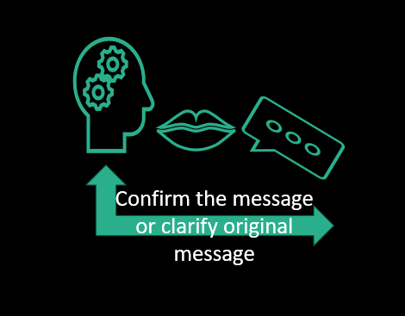

Effective Communication
Effective Communication

Slide 36
"Your ability to communicate your perspective will determine the quality of your life."
Rhonda Sciortino
Author

Slide 37




I WILL...
assume everyone has something worthwhile to say.
notice the feelings behind the words and watch for body language.
stop myself from thinking about other things while the other person is talking.
face the person who is talking and keep eye contact.
not interrupt the speaker to make a point.
not be distracted by other demands of my time.
ask questions to get more information and encourage the speaker to keep talking.
repeat my own words to show understanding.
use questions to guide the speaker so they can make their message clear to me.
Mastering Interpersonal Skills

Slide 38


What is Perspective?
We each tie emotions to our interactions without knowing it.
We see things differently and draw conclusions from the same things.
We look at life through the emotions we are feeling.

Slide 39




Slide 40

Pro Tip
When you start thinking to yourself:
"Why are they overreacting, it's NOT a big deal!"
That is your indicator to stop what you are doing and to be open to the other person, it is a big deal. By doing this, you can better understand the other person.

Slide 41


Collaboration
There will be times when you will need the input of others to come to a decision. Learn to recognize when collaboration is needed.

Slide 42


Shared Goals & Shared Responsibilities
Teamwork is a cooperative and coordinated effort on the part of a group of people acting together as a team in the interests of a common cause. What does the company you are working for need to do?

Slide 43





Decision-Making
& Problem Solving

Slide 44

Growth Mindset
Cultivating a mindset to look at problems as opportunities of growth.
What can the situation teach you?

Slide 45


Successful Navigation
We are in control of our real-life narrative and can navigate unexpected twists and turns for our personal and professional paths.
The key is to be flexible, keep a growth mindset, and embrace the willingness to grow.
It's not always important to pursue our first plan but to be able to thrive when we need to go with Plan B, Plan C, etc.
Embrace the unexpected - your next career defining moment may lie within that detour from the intended route.

Slide 46

Define the problem, challenge, or opportunity
Think of possible solutions and responses
Think of the pros and cons for each option
Select the best option for the situation
Put your decision into action
Think of the impact of your decision and modify the action as needed
Helpful Tip: Skipping steps usually leads to poor outcomes. Think of ways to help you to not overlook important information or misunderstanding the situation.

Slide 47


Safety
Understand proper safety procedures
Understand hazards of the process
Recognize potential safety hazards
Propose new safety procedures and revisions to existing ones

Slide 48


Dealing with Negativity
Page 16
Stay patient to create space
Don't take it personally
Negativity short-circuits your brain and provokes reactions without thought
Don't give in to impatient urges. Instead, breathe deeply and create space
Approaching a situation with a clear head will prevent something you will regret

Slide 49

How to
De-escalate
Understand their concerns.
Acknowledge their difficulties.
Be reliable and knowledgeable.
Always offer assistance, if you can't help them, find someone who can.
Avoid becoming part of the problem.

Slide 50

Career Path
Live Your Dream

Slide 51

Jobs
offer steady employment but limited room for growth.
Careers
offer the chance to acquire skills and opportunities for career moves and salary increases.

Slide 52



Career Pathways
Entry-Level
Trade
Profession
Designed for recent graduates which typically does not require prior experience.
Requires advanced training and skills gained through attending trade school. Significant experience and training is required.
An occupation (like medicine, law, or teaching) that requires specialized knowledge and specified amount of college.

Slide 53


Job Application Checklist
Preparation is key to a successful job search. These following steps will help your frustration and improve your success in the long run.
To apply online you will need:
Access to the internet
Email address for job searching
Up-to-date resume
Employment history
References
Determine your work availability
Read, then re-read before you submit

Slide 54



Preparation Essentials: The 3 R's
Page 22
1
2
3
Reflect
What do you like to do? What do you want to do? Change in Career Field? What’s it going to take?
Research
Search for jobs that you are interested in through multiple resources to see the requirements needed, and take your Traitify career assessment into consideration.
Review
Create a career blueprint of the info you gathered and create action steps to achieve it

Slide 55

Career Blueprint
A strategy to help you identify your next career move by assessing the directions, action steps, and obstacles that may come your way - all so you can reach your dream career goal.

Slide 56

Interest Map
Page 22
Learn more about yourself by paying attention to your interests:
Write down all your interests
Look for patterns in the things that you enjoy
Start creating your long-term goals

Slide 57

Vision Board
Page 22
Think of the life you want to live.
You can use a poster board and gather old magazines, search online and print out, or you can draw/paint things that represent your hopes and dreams.
You can create a digital board and save the image as your home screen wallpaper on your phone and/or computer.
Place it somewhere that you can stay on track.
Having a visual of your goals will help you picture how your choices can impact your future.

Slide 58




Career Sweet Spot
When you find a job where you can do the things you love to do, you won't be paid for a job. You will be paid for your time instead.
Passion
Purpose
Rewards

Slide 59


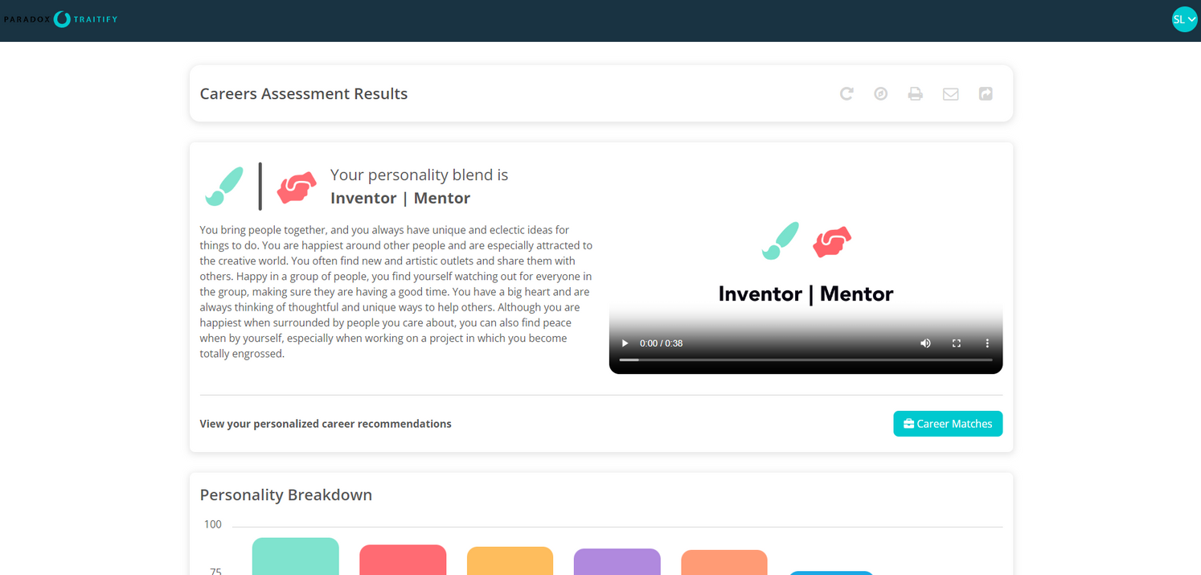

Career Assessment
When you visit ntx.traitify.com and create a free candidate account you can see what your personality blend is and see what your career matches are.

Slide 60





Using the SMART Goal method helps you achieve your dreams! By clarify your ideas and breaking them down into manageable action steps and timeframes, you can accomplish so much more!
Page 23
A dream is only a dream until you write it down. Once you write it down, it becomes a goal.
A goal is a process of identifying something you want to accomplish.
Finding and remembering your motivation is important to keep working on any goal you set.
Start thinking of the life you want. Where do you see yourself in 3 months, 6 months, a year, 10 years from now? What do you need to do to make it happen?
Your Ideas
Make a List
Success!

Slide 61

“Many of life's failures are people who did not realize how close they were to success when they gave up.”
Thomas Edison
Inventor and Businessman

Slide 62


Elevator Speech
Imagine...
You are in an elevator standing next to a person you admire in the career field you are interested in.
What would you say about yourself in the time the elevator doors close and the button for the floor is pushed?
What would you say about yourself before you reach your floor that could potentially change your life?

Slide 63

Let's Craft Yours!
Quick Introduction
What are you seeking?
Experience
What can you offer?

Slide 64
Page 25
Your Elevator Speech
Describe your skills and abilities in the spaces provided in this template to help you come up with yours.
Good afternoon/evening, my name is _______________________, I want to pursue a career in ______________________.
and have been ____________________________________________ to prepare.
I would love a chance to ____________________ at your organization.
May I _______________ you to schedule a time to discuss?
(Career Field)
(Academic/Volunteering/Work Experience)
(Intern/Volunteer/Work)
(Call/Email)

Slide 65













Tips for Networking Face-to-Face
OPEN THE CONVERSATION
INITIATE THE HANDSHAKE
USE YOUR ELEVATOR SPEECH
ACT IS IF YOU ALREADY KNOW THEM
SPEAK WITH CONFIDENCE AND A POSITIVE ATTITUDE
ASK QUESTIONS THAT ARE MEMORABLE

Slide 66


Mentorship
Page 26
Find someone in your dream career:
Write down questions you want to ask them
Contact them to set up a time to talk with them

Slide 67
Resume Building
Your resume should include:
Your Full Name
Activities and Awards
Planning and developing your resume should display who you are and what your career goal is.
What you are doing to pursue that career.
Update your resume once you start a job, get new responsibilities, new trainings, internships, or when your job ends. That way you have an updated resume at any time.
Phone Number
Volunteer Activities and Extracurriculars
3 References
Email Address
City and State
Work Experiences
Education

Slide 68



Rocking Your Next Interview
An interview is just a conversation between the interviewer(s) and the interviewee, where questions are asked to help narrow down the best fit and where the interviewee is seeing if the company is the right fit for them.
Look at the job description and research the company.
Examine yourself to be able to answer the interviewers' questions and to be comfortable during the interview.

Slide 69
Why Do Employers ask Behavioral Questions?
These questions are intended to help employers understand your future behavior based on specific experiences from your past.

Slide 70
Page 29
Tell me about yourself.
Pick a couple of points about yourself: Job or volunteer experiences and accomplishments.
Why should we hire you?
Briefly lay out your strengths, qualifications, and what you can do in the position if given the opportunity.
Be Prepared

Slide 71



START Method
You can answer any of the interviewer's questions with this format:
What was the Situation?
What Task needed to be done and why?
Explain your specific Action.
What was the Result?
What Take-away did you learn from the situation? What would you have done differently?

Slide 72


What is your greatest weakness?
Page 29
The key is to recognize that a weakness is only the downside of a given strength.
Examine your weaknesses and think of steps to correct them.

Slide 73

When an interviewer asks “Do you have any questions for me?” What do you say?
Is this a new or vacant position?
What would you like to see accomplished in this job that hasn't been already?
How is performance measured?
Would you tell me a little bit about your experience with the company?
What type of support does this position receive in terms of people, equipment, finances, etc.?

Slide 74



Gold Nuggets
to Stand Out After the Interview
During your interview, ask for your interviewer’s email address. Send a thank you email, card, or letter.
Thank them for their time, this is an opportunity to show your character, to answer any questions, and ask questions you forgot during your interview.
This will help you to stand out from the other candidates.

Slide 75

Why Attend Job Fairs
Job Fairs give you a chance to speak one-on-one with multiple company representatives all in one place.
You could leave with your new schedule in your hand!
If you don't land an interview on the spot, you still have the chance to make a great impression.

Slide 76

Timesheet Requirements & Payroll Processes

Slide 77

Payroll
Payroll due dates are when the time you worked is submitted.
It usually takes a week for processing.
Paydays can be weekly, bi-weekly, semi-monthly, or monthly.
Talk to your employer about their company policies and procedures on their payroll.

Slide 78

Money Value
Page 31
Calculate the hours of days an item is worth by how much you get paid an hour.
Is the item worth "X" hours of your time to pay for it?

Slide 79

Needs
VS
Wants
Things that make life easier and enjoyable but are not needed for our survival
Things that you need to survive
Food
Shelter
Clothing
Personal care items
Entertainment Electronics
Toys

Slide 80

Budgeting
Page 32
Write down your income.
List your expenses.
Subtract them from your income.
If it's less than zero, increase your income or reduce expenses.
Track expenses throughout the month.
See where your money goes.
Limit spending.
Save money.

Slide 81

Stacey Lingbeek
(940) 322-1801 ext. 5114
Stacey.Lingbeek@ntxworksolutions.org
Thank you!
Hybrid Workshop Schedule
Monday-Friday
9am-11:30am
Workforce Solutions North Texas is an equal opportunity employer/program. Auxiliary aids and services are available upon request to individuals with disabilities. Relay Texas: (800)735-2989 (TDD) or (800)735-2988(Voice) or 711
Job Searching
Goal Setting
Money
Rock Your Next Interview
Maximize Your Hireability

